Slide 1
– Web Application Concepts –
PHP
CPRG 210
Web Application Concepts
PHP
Notes:
02/01/19
02/01/19

Slide 2
– Web Application Concepts –
PHP
Regular Expressions
Notes:
02/01/19

Slide 3
– Web Application Concepts –
PHP
Pattern Matching
Perl compatible
  preg_match()
Note:
  preg_match needs // around the pattern
test_regex.php
regex.php
Notes:
02/01/19
http://xkcd.com/208/
02/01/19

Slide 4
– Web Application Concepts –
PHP
Pattern Matching
preg_match(“/pattern/”, “string” [, array $match]);
  Case sensitive search
  To ignore case, add an i after pattern
  Returns number of matches
  Puts matches in array of arrays of matches
  Eg. if (preg_match(“/[^a-z]/",$username, $match))
  echo "Username must be all lowercase!";
  preg_match_all (“/pattern/”, “string”, [$match]);
    Same as preg_match, but is global
Notes:
02/01/19
http://ca3.php.net/preg_match_all
02/01/19

Slide 5
– Web Application Concepts –
PHP
Pattern Matching
Metacharacters
. Single character
? Zero or one times
+ one or more times
* zero or more times
^ start of string
$ end of string
Notes:
02/01/19
http://www.zytrax.com/tech/web/regex.htm#intro
02/01/19

Slide 6
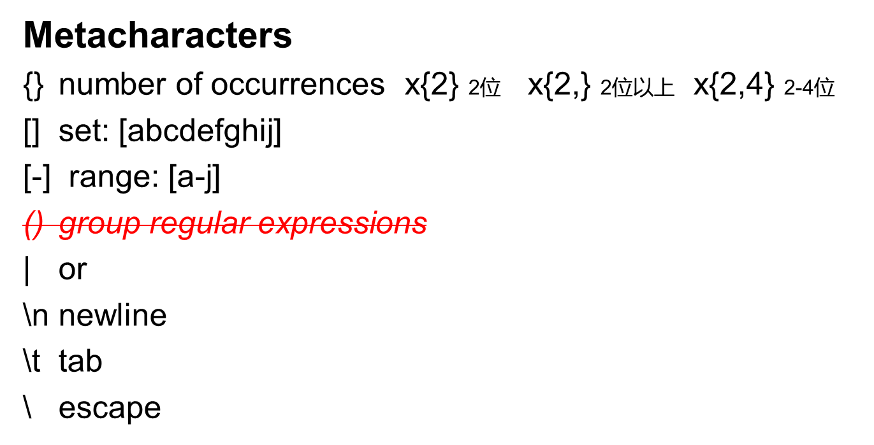
– Web Application Concepts –
PHP
Pattern Matching
Notes:
02/01/19
http://www.zytrax.com/tech/web/regex.htm#intro
02/01/19

Slide 7
– Web Application Concepts –
PHP
Pattern Matching
Sets & ranges
  [Aa12], [a-z], [^list]
    matches any of the characters in the [ ]
    “-” is a range
    “^” is a not
Notes:
02/01/19
http://www.zytrax.com/tech/web/regex.htm#intro
02/01/19

Slide 8
– Web Application Concepts –
PHP
Pattern Matching
match/replace
  preg_replace(“/pattern/”, “replace”, “string”)
  preg_replace(“/pattern/i”, “replace”, “string”)
    Returns the modified string
Notes:
02/01/19
02phonenumber.php
02regex - email.php
02/01/19

Slide 9
– Web Application Concepts –
PHP
Do It
Add on to your PHP database script
  Add a regular expression to check if the agent phone number is properly formatted
  Use phonennumber.php as an example
Notes:
02/01/19
http://atcogas.com/Meter_Reads/submit_your_meter_3Dials_File_site_ID.asp
02/01/19

Slide 10
– Web Application Concepts –
PHP
Files & Directories
Notes:
02/01/19

Slide 11
– Web Application Concepts –
PHP
Files
fopen()
  $filepointer = fopen(“filename”, “mode”);
$array = file(“filename”);
  reads entire file into array
fwrite()
  fwrite($filepointer, “string”);
fclose()
  fclose ($filepointer);
file.php
file1.php
file2.php
Notes:
02/01/19

Slide 12
– Web Application Concepts –
PHP
File & Directory handling
rename(“old name”, “new name”);
$number = filesize(“filename”);
$handle = opendir(“path”);
while (readdir($handle))
{
statements;
}
closedir($handle);
is_file(“filename”);
fileread.php
Notes:
02/01/19
03file.php
03file1.php
03file2.php
03file3.php
03fileread.php
02/01/19

Slide 13
– Web Application Concepts –
PHP
Simple Data Encryption
PHP uses password hashing API now to keep hashing up to current standards.
http://php.net/manual/en/intro.password.php
password_hash($password, PASSWORD_DEFAULT);
password_verify($user_pass, $db_pass)
Suggests using 255 characters in DB for future possibilities.
Notes:
02/01/19
genuserfile.php
http://gdataonline.com/seekhash.php
02/01/19

Slide 14
– Web Application Concepts –
PHP
Do It
Add on to your PHP database script
  You want keep a log of the SQL queries. Each time there is a successful insert into the table agents, write the SQL query to a file called agents_table.log
Notes:
02/01/19
02/01/19

Slide 15
– Web Application Concepts –
PHP
Cookies
setcookie(“name”, “value”, expire_time)
$_COOKIE[‘name’]
to delete cookie, set expire_time to a time in the past
cookie1.php
cookie2.php
cookie3.php
cookie4.php
Notes:
02/01/19

Slide 16
– Web Application Concepts –
PHP
Do It
Modify your Agent entry page to display the time you started entering agents
  When the page loads for the first time, create a cookie and store the current time using time()
  Each time the page is submitted and reloads, read the cookie with PHP and display it
Notes:
02/01/19

Slide 17
– Web Application Concepts –
PHP
Sessions
HTTP is stateless
  need a way to simulate a dedicated connection
Cookies allowed storage of data on client computer
  Inherent problems
    user can use different machines
    can’t store data on public machines
    user can block cookies or delete cookies
Notes:
02/01/19

Slide 18
– Web Application Concepts –
PHP
Sessions
URL Rewriting
  appends sessionID and data to URLs that are sent back and forth
  doesn’t use cookies, so not affected by users
  problems
    session visible as part of URL
    session is over if user goes to another site and comes back later
    user could bookmark a session!
Notes:
02/01/19

Slide 19
– Web Application Concepts –
PHP
Sessions
Current solution is to assign a session ID (SID) to site visitor and use it as a link to session data
  Stored in a cookie
  Attached to end of URLs that are sent to the client
Notes:
02/01/19

Slide 20
– Web Application Concepts –
PHP
Sessions
Starting a session
  session_start();
Creating session variables
  $_SESSION[“name”] = “Aaron”;
Deleting session variables
  unset($_SESSION[“name”]);
session1.php
session2.php
Notes:
02/01/19
http://ca3.php.net/function.session-start
http://ca.php.net/manual/en/session.examples.php
http://ca.php.net/manual/en/session.configuration.php#ini.session.use-trans-sid
Show tmp directory
02/01/19

Slide 21
– Web Application Concepts –
PHP
Do It
Use a session to store the start-time
Display how long the user has been “logged-in”
Notes:
02/01/19

Slide 22
– Web Application Concepts –
PHP
File Upload
Web Applications such as webmail need the ability to upload files to send as attachments
  Also Dropbox, Google Drive, etc.
PHP can receive files via HTML forms
  input type=“file”
fileupload.php
Notes:
02/01/19
fileupload.php
Read warning! http://www.tizag.com/phpT/fileupload.php
02/01/19

Slide 23
– Web Application Concepts –
PHP
File Upload
File is transmitted as form data and received into a temporary storage directory
Data about the file is received in $_FILES
  2-dimensional Associative Array
    name, temp_name, size, type, error
move_uploaded_file() used to transfer file from temp directory to destination directory
Notes:
02/01/19
fileupload.php
Read warning! http://www.tizag.com/phpT/fileupload.php
02/01/19

Slide 24
– Web Application Concepts –
PHP
File Upload
Allowing file uploads to your server has risk that files could contain malware
Read warning! http://www.tizag.com/phpT/fileupload.php
Notes:
02/01/19
fileupload.php
Read warning! http://www.tizag.com/phpT/fileupload.php
02/01/19

Slide 25
– Web Application Concepts –
PHP
Exercise
Do the exercise in
“CPRG210 Exercises Day 12.doc”
Notes:
02/01/19

